Slide 1

Predicting Taxi Ride Duration
INST737 Final Project
Riya Chanduka, Lindsay Huth, Mayanka Jha, and Aakanksha Singh

Slide 2

A taxi goes from Chinatown to Times Square. How long will it take to arrive?

Slide 3

Introduction
There are roughly 200 million taxi rides in NYC each year. Analysis and understanding of taxi supply and demand could increase the efficiency of the city’s taxi system. Predicting taxi ridership could present valuable insights to city planners and taxi dispatchers.
Input:
Date, start and end points, distance etc.
Output:
Predicted travel time of a ride
Notes:
The ability to predict taxi ridership could present valuable insights to city planners and taxi dispatchers in answering questions such as how to position cabs where they are most needed, how many taxis to dispatch, and how ridership varies over time.

Slide 4

Our Pitch
The Problem:
Dispatchers for taxi companies need to send cars around New York City to meet requests for rides. The companies need to be able to estimate the duration of rides so they know when cars will be available to take the next passenger.
Our Solution:
Use NYC taxi historical data to build a model that predicts the duration of rides, which we can pitch to taxi companies.

Slide 5
The Data
Field | Description
id | Unique identifier
vendor | Code for cab company
pickup_datetime | Date and time meter started
dropoff_datetime | Date and time meter ended
passenger_count | Number of passengers
pickup_longitude | Longitude meter started
pickup_latitude | Latitude meter started
dropoff_longitude | Longitude meter ended
dropoff_latitude | Latitude meter ended
store_and_fwd_flag | Whether trip data was sent to server immediately
trip_duration (train) | Duration of trip (seconds)
Source: NYC Taxi and Limousine Commission
Train set: 1458644 records
Test set: 625134 records

Slide 6


Project Outline
Tools Used
Data Exploration
Transforming data into readable format
Feature Engineering
Building Different Models
Model Selection
Results
Python
Matplotlib
Seaborn
Jupyter Notebook

Slide 7
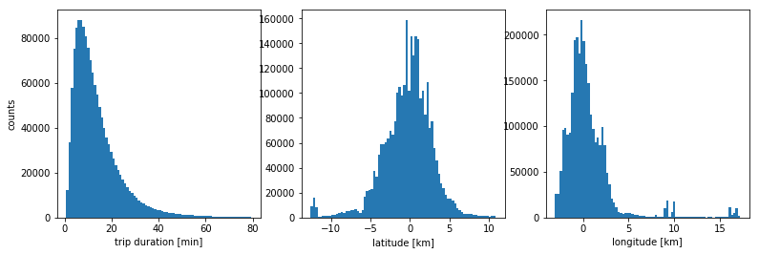
Cleaning and Exploration
Steps:
Check for nulls
Remove outliers
Convert units: duration from sec. to min. and location from lat/long to km

Slide 8
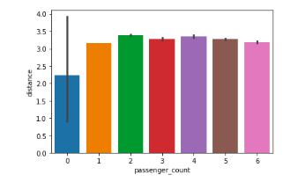
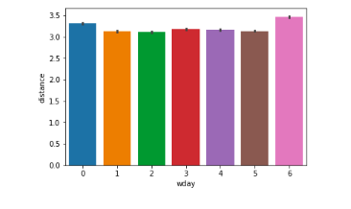
Calculating distance between the pickup point & drop off point
The graph shows the distribution of average distance travelled for different passenger counts.
The graph shows the distribution of average distance travelled over the days of the week.
The largest distance was covered on the weekend

Slide 9
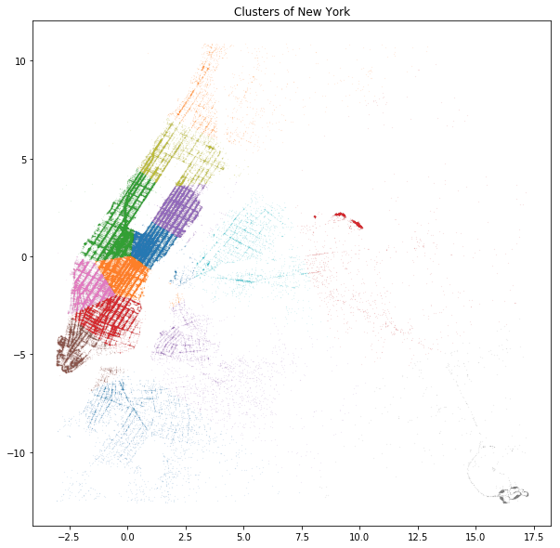
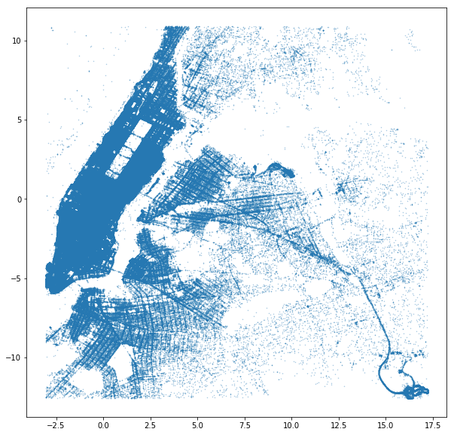
Initial Maps and Clusters
Let's cluster New York City based on the pick-up and drop-off points of each taxi ride:
As we can see, the clustering results in a partition which is somewhat similar to the way NY is divided into different neighborhoods. We can see Upper East and West side of Central park in light blue and green respectively. West midtown in pink, Chelsea and West Village in orange, downtown area in red, East Village and SoHo in purple.
The airports JFK and LaGuardia have there own cluster, and so do Queens and Harlem. Brooklyn is divided into 2 clusters, and the Bronx has too few rides to be separated from Harlem.
Notes:
For outlier detection on each row I decided to simply use 0.3% and 99.7% percentile for latitude and longitude

Slide 10
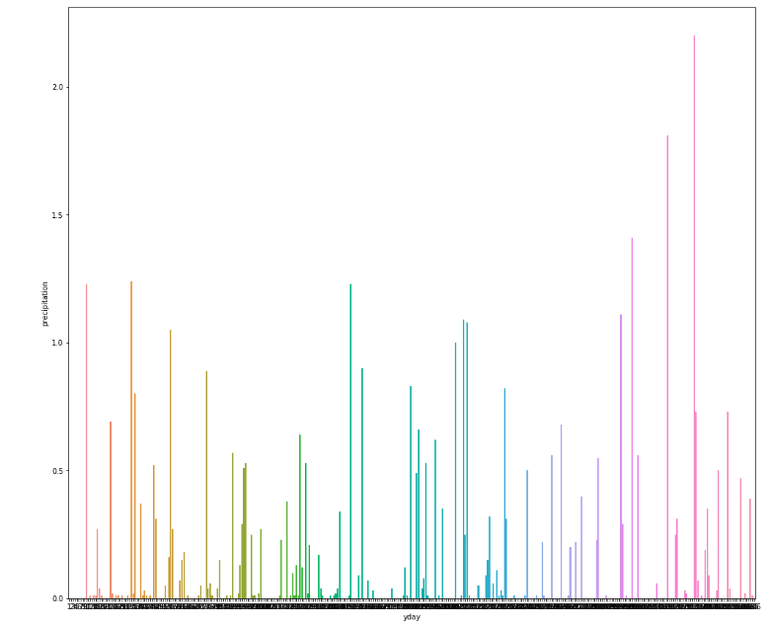
Adding Weather Dataset
Field | Description
date | First 6 months of 2016
maximum_temp | Max temp in Fahrenheit
minimum_temp | Min temp in Fahrenheit
average_temp | Average temp in Fahrenheit
precipitation | Precipitation
snow_fall | New snowfall
snow_depth | Current snow depth in inches
Weather can play an important role in influencing traffic. Both the increase of traffic as well as the decrease of road conditions increases the travel time.
Extracted the day of year from the date column.
The variation of precipitation over the year 2016:

Slide 11
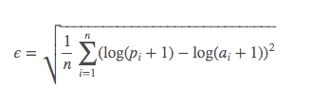
Evaluation Metrics
The evaluation metric for this competition is Root Mean Squared Logarithmic Error. The RMSLE is calculated as:
Where:
ϵ is the RMSLE value (score)
n is the total number of observations in the (public/private) data set,
Pi is your prediction of trip duration, and
ai is the actual trip duration for ii.
log(x) is the natural logarithm of x

Slide 12
Building the Model
Several models with different sets of features were built. The three Machine Learning models which we explored in this project are:
Linear Regression
Gradient Boosting
Lasso Regression
The Weather dataset didn’t add any value to the model, so we built models without it.

Slide 13
Feature Selection Stage 1
Features Selected:
Vendor_id
Passenger_count
Pickup_longitude
Pickup_wday
Pickup_yday
Pickup_hour
Model 1: Linear Regression
The model gave us a RMSLE of 0.73
Model 2: Ridge Linear Regression
The model gave us a RMSLE of 0.73
Model 3: Gradient Boosting
The model gave us a RMSLE of 0.73

Slide 14
Feature Selection Stage 2
Model 4: Gradient Boosting
Features Selected:
Vendor_id
Passenger_count
Pickup_longitude
Pickup_latitude
Dropoff_longitude
Dropoff_latitude
Trip_duration
Haversine_dist
Bearing_dist
Manhattan_dist
Pickup_month
Pickup_day
Pickup_hour
store_and_fwd_flag
Results:
RMSLE = 0.68

Slide 15
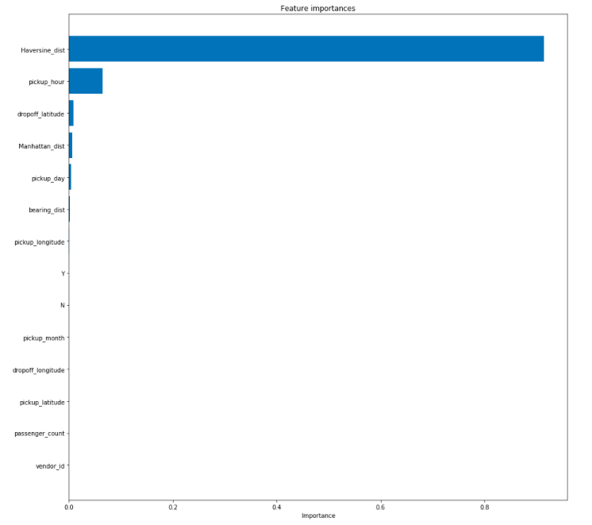
Feature Importance
We used Gradient Boosting feature importance parameters to check the important features:
features_list = b_train.columns.values
feature_importance = GBR.feature_importances_
sorted_idx = np.argsort(feature_importance)
plt.figure(figsize=(15, 15))
plt.barh(range(len(sorted_idx)), feature_importance[sorted_idx], align='center')
plt.yticks(range(len(sorted_idx)), features_list[sorted_idx])
plt.xlabel('Importance')
plt.title('Feature importances')
plt.draw()
plt.show()

Slide 16
When we uploaded the predicted output, we got a score of 0.68. Hence, we re-selected our features based on the feature importance. The new features which were selected are:
Vendor_id
Passenger_count
Pickup_longitude
Pickup_latitude
Dropoff_longitude
Dropoff_latitude
Store_and_fwd_flag
Month, Day, weekday, hour, minute - extracted from pickup_datetime
dist_long, dist_lat, dist - extracted from distance between pickup longitude, dropoff longitude, pickup latitude and dropoff latitude
Trip_duration
Model 5: We created a Gradient Boosting model based on above features which gave us a RMSLE of 0.383

Slide 17
Comparison of Models
Feature Selection Stage | Model | RMSLE
Stage 1 | Linear Regression | 0.731
Stage 1 | Ridge Linear Regression | 0.73
Stage 1 | Gradient Boosting | 0.73
Stage 2 | Gradient Boosting | 0.68
Stage 3 | Gradient Boosting | 0.38

Slide 18
Results
Based on the RMSLE value, we chose Gradient Boosting for our final model. 16 features were selected to build this model:
Vendor_id
Passenger_count
Pickup_longitude
Pickup_latitude
Dropoff_longitude
Dropoff_latitude
Store_and_fwd_flag
Month, Day, weekday, hour, minute - extracted from pickup_datetime
dist_long, dist_lat, dist - extracted from distance between pickup longitude, dropoff longitude, pickup latitude and dropoff latitude
Trip_duration

Slide 19
Conclusion
Our model can…
Help taxi dispatchers assign requested trips to available cars, making their services more efficient
Help city planners understand duration of trips people are taking to better accommodate taxis

Slide 20

THANK YOU

